Slide 1
Evaluating Online Sources

Slide 2

Traditional Research
It used to be that doing research involved
  Going to a library
  Using a card catalog to locate sources
  Finding books or back issues of newspapers or magazines
  Making photocopies of the sources you plan to use

Slide 3

Online Research
Today, most research involves
  Online databases
  Internet searches
  Electronic copies of sources
You may or may not need to physically go to the library

Slide 4
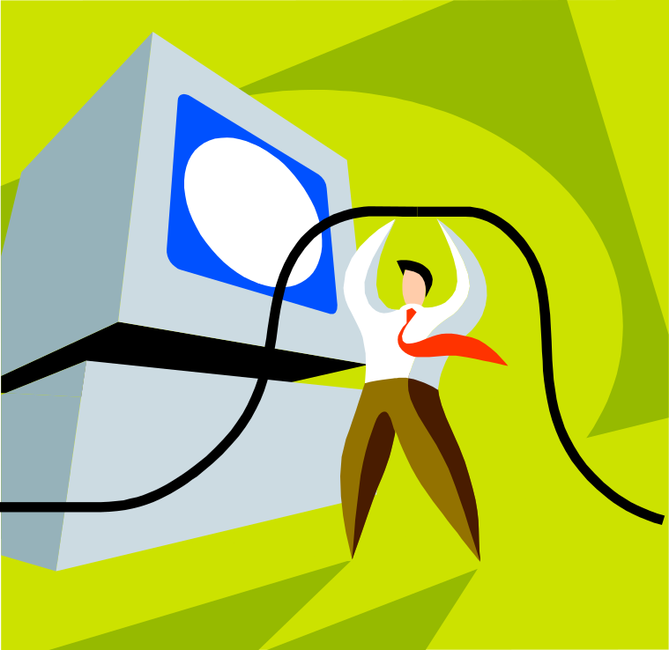
Advantages of Online Research
Online research can be convenient and quick
It also provides a large quantity of diverse sources – you are not limited to the holdings of just one library

Slide 5

Disadvantages of Online Research
At the same time, the volume of information available can be overwhelming
Not all of the information online is reliable, so evaluation of sources is vital

Slide 6

Reliable Sources
Before you use a source as evidence for an essay or other project you are working on, you need to make sure it is reliable – that it will provide credible support for your argument

Slide 7


Slide 8

Characteristics of Reliable Sources
Reliable sources have
  Authority
  Objectivity
  Currency
When evaluating online sources, be sure to check for all three elements

Slide 9

Judging Authority
What credentials does the author have?
Does the author have an affiliation with an institution such as a university, a research institute, or publication?

Slide 10

Judging Objectivity
Is the author an advocacy organization?
Is the author a private individual expressing his or her own personal views?

Slide 11

Be Suspicious!
Some websites are actually “masks” or “shells” that are being used to sell advertising. They have no author who can be identified, so they are not reliable.

Slide 12

Judging Currency
Look for a publication date or an “updated on” date on the website
If there is no date, can you somehow confirm that the information is current?

Slide 13
Analyzing URLs
As you are evaluating websites for reliability, it can help to analyze the URL (or web address) to determine the type of website you are looking at
  .com = commercial (be careful – the site’s main purpose is to sell something)
  .gov = government (typically reliably but check currency)
  .org = nonprofit (consider whether the organization has any bias or political motive)
  .edu = educational institution (check to see if the page is from the school itself or a personal page of a student or teacher)

Slide 14


Slide 15
Campus Resources
One of the best resources for your online research is the college’s library
The library has subscriptions to many online databases
These databases can be accessed on campus or from home with a password (contact the reference desk at 661-362-3358 or 661-362-3362 for off-campus access to these databases)

Slide 16
Online Databases
Online databases are searchable collections of research material, usually article-length sources
Some online databases are general and include a wide variety of topics and sources while others are specific to a particular discipline
A big advantage of online databases is that the sources are already screened for reliability
Some online databases also have additional tools to help you organize your research

Slide 17
Examples of Online Databases
Proquest Direct: Includes more than 10,000 magazines, journals and newspapers – helpful for most research projects
CQ Researcher: Highly-respected current-events resource on topics ranging from social and teen issues to education, environment, and science
Daily Life Through History: Comprehensive, cross-disciplinary resource that supports history, social studies, English, and language students; gives life to history and context to current events

Slide 18
How to Access Online Databases
To get started with one of the library’s online databases, go to the library website: www.canyons.edu/library
Go to the “Research Here” menu at the top of the page and select “Online Databases”
Select the database you’d like to use
  On-campus, no password is needed
  Off-campus you will need a password (contact the reference desk at 661-362-3358 or 661-362-3362 for off-campus access to these databases)

Slide 19

Internet Research
Another way to do online research is to search for sources using the internet
There is a lot of good information available this way, but you do need to be more careful to evaluate the sources you find

Slide 20

Specialized Sites
In addition to regular search engines (like Google), you can also use sites that are more specialized
  Internet Public Library (sources screened by librarians): www.ipl.org
  Google Scholar (scholarly sources only): www.scholar.google.com

Slide 21

Wikipedia
Wikipedia should be used with caution (if at all) in academic papers
  Anyone can edit the pages, which brings reliability into question
  Wikipedia itself encourages readers to verify information before using it

Slide 22
Typical websites that offer reliable evidence
Government agencies
Universities
Research institutes that are affiliated with governments or universities
Newspapers
Professional journals
Professional associations
Subscriber database services such as Proquest and Issues and Controversies

Slide 23

Typical websites that do not offer reliable evidence
Advertising masks or shells
Advocacy organization websites
Political organizations
Personal websites
Discussion boards

